Slide 1
Multi-Agent Orchestration in Copilot Studio
Working with Connected Agents and Child Agents

Slide 2



SANDEEP ANGARA
Senior Specialist, Protiviti India Member Firm
Copilot Studio
Power Automate
Power Apps
Microsoft Foundry
Azure
Web Technologies
sandeep-angara
hisandeepangara.github.io

Slide 3
Agenda
What is Orchestration in agents
Multi-Agent Orchestration
Child Agents
Connected Agents
Multi-agent patterns
Demo

Slide 4
Generative orchestration
Plan generation
Topic
Topic
One or more tools / topics / knowledge matched
A plan is generated using tools / knowledge / topics
Tool
User utterance
Topic
Slot filling
Unified Response
A message is generated to answer a user’s question using the outputs from all tools / knowledge / topics in the plan.
Tool
Execution
Tool
Response
Knowledge
Knowledge
Knowledge
Search
Summarize
Fallback System Topic
“Sorry, I didn’t understand that”
Citations
Notes:
Generative orchestration means the agent uses AI to dynamically decide how to answer a question by combining its built-in language skills with information from your added knowledge sources.
When a user asks a question, the agent:
Understands the question using AI.
Can ask users for missing information by generating questions on the fly.
Selects the most relevant knowledge sources.
Searches those sources for answers.
Generates a natural, helpful response using the information it found.

Slide 5
Multi-Agent Orchestration
Copilot Studio Agents can orchestrate over child and connected agents. While child agents are fully owned by the main agent, connected agents are fully independent agents that can run standalone.
Child agents are ideal for modularizing logic within your main agent, while connected agents can handle more complex scenarios and can be reused by multiple main agents.
Multi-agent architecture helps bypass the 128 tools limit at agent level (each child-agent or connected agent can also have up to 128 tools as this is orchestrated by a second LLM call – downside: it adds latency)

Slide 6
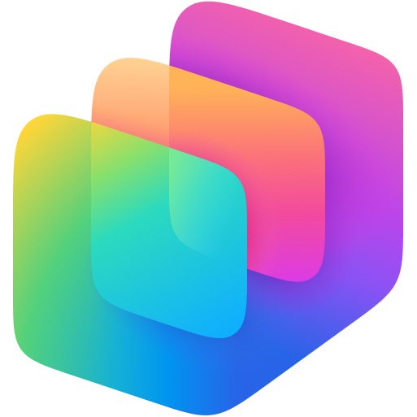
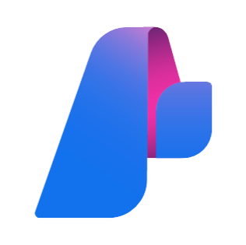


Copilot Studio agent
Connected agents
System Instructions
System Topics
User Topics
Child Agents
Copilot Studio
agents
Knowledge
Tools
Fabric Data Agents
Websites
Connectors
Flows
Prompts
Orchestrator
Azure Foundry
SharePoint
OneDrive
Any agent via Agents SDK
Dataverse
MCPs
Computer use
Rest APIs
AI Search
Any other A2A Agent
Custom KBs

Slide 7
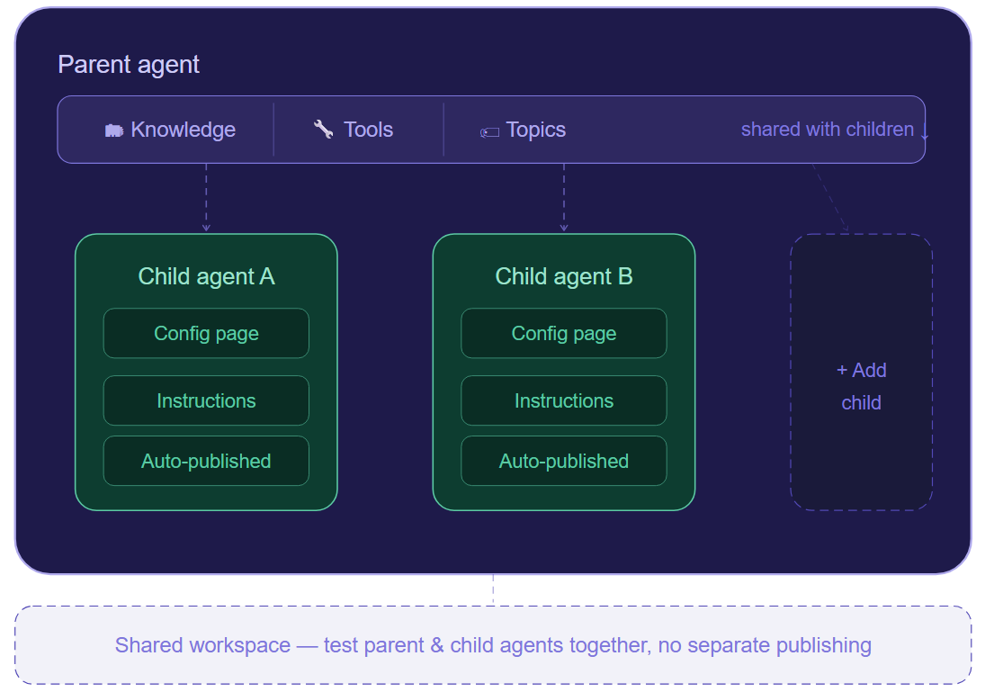
Child Agents
Child agents are lightweight specialists live within the parent agent, sharing its tools, knowledge, and topics — all configured from a single workspace without separate publishing.
Changes to parent and child agents are made and tested together, making iteration faster and simpler.

Slide 8
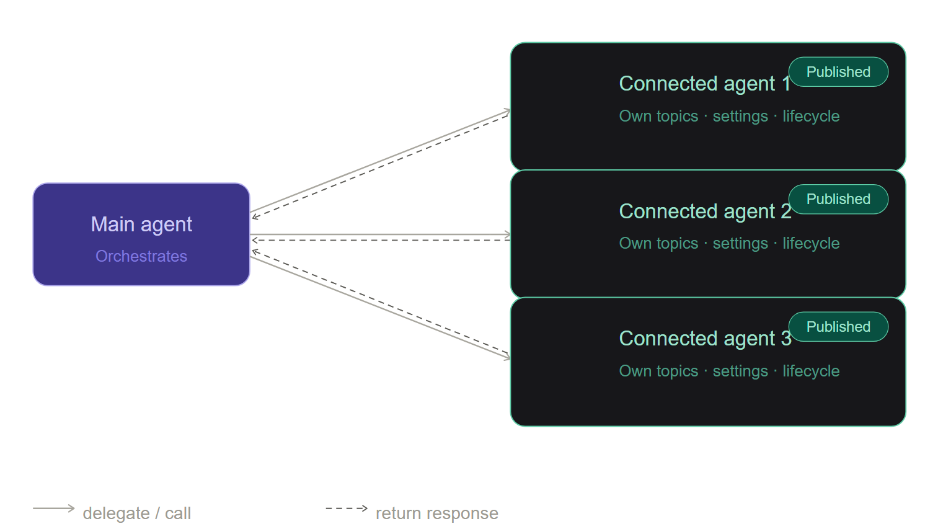
Connected Agents
Connected agents are fully independent - each with their own topics, settings, and deployment lifecycle - collaborating with your main agent like separate departments on a shared project.
Connected agents must be published before another agent can use them, including during active testing.

Slide 9
Which should I use?
Use child agents when:
You have a single developer or a small, cohesive team managing the entire agent solution.
You want to logically group tools, instructions, or knowledge into clearly defined child-agents within a larger agent.
You do not need separate configuration settings.
You do not intend to publish these agents separately or make them available independently to end users.
Use connected agents when:
Multiple teams or developers manage different agents independently.
You need to publish and maintain agents separately, making them available directly to end users on independent channels.
Agents must have their own dedicated settings, including authentication configurations.
You need independent Application Lifecycle Management (ALM) processes for each agent.
Note: multi-agent architecture helps bypass the 128 tools limit at agent level (each child-agent or connected agent can also have up to 128 tools as this is orchestrated by a second LLM call – downside: it adds latency)

Slide 10
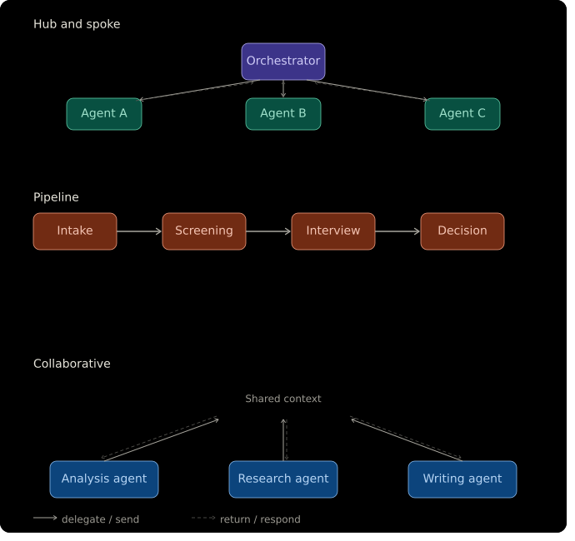
Multi-Agent Patterns

Slide 11
DEMO

